Slide 1
Share the Blessings
Web changes
2016 June Relaunch

Slide 2
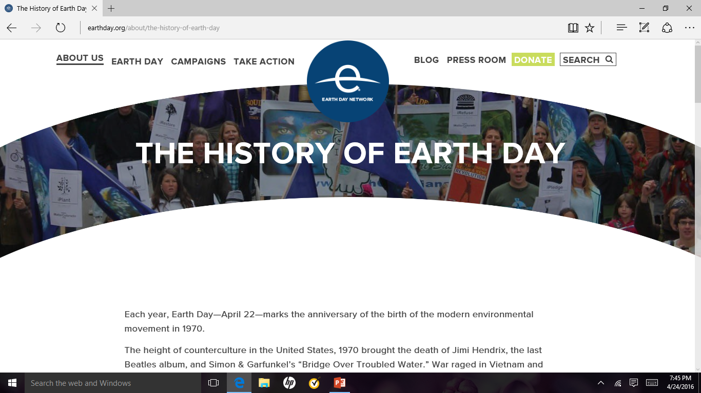
Sample web site www.earthday.org

Slide 3
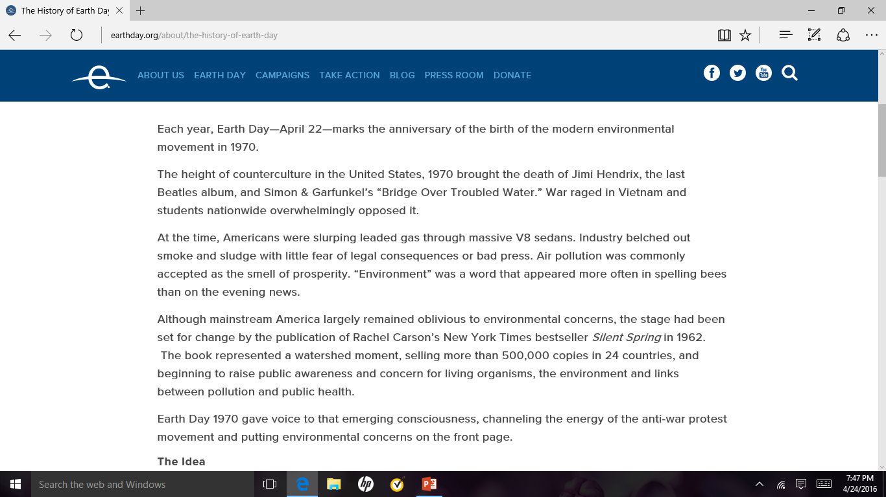

Slide 4
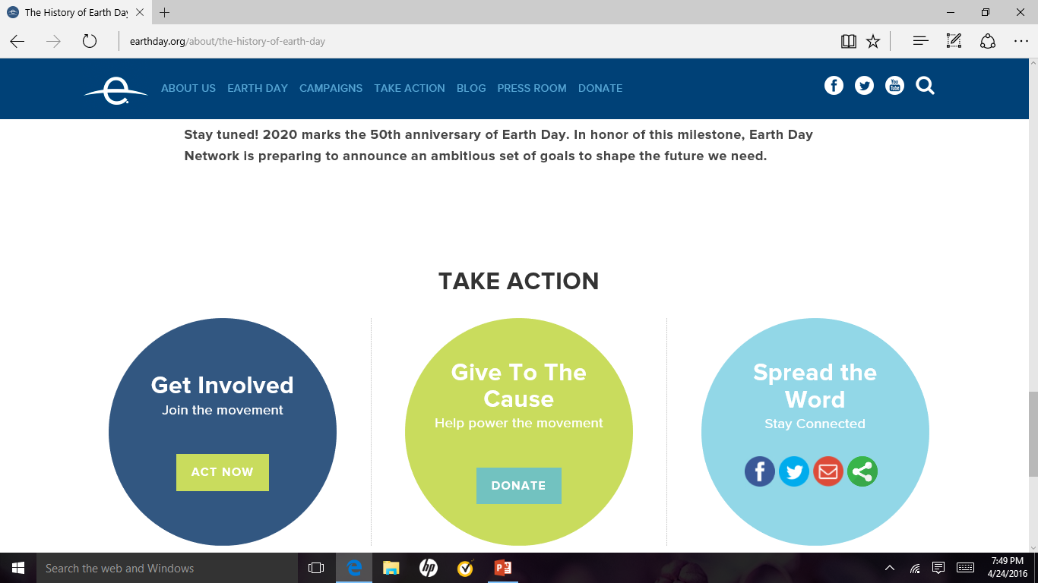
Here is the bottom of Earthday.org

Slide 5
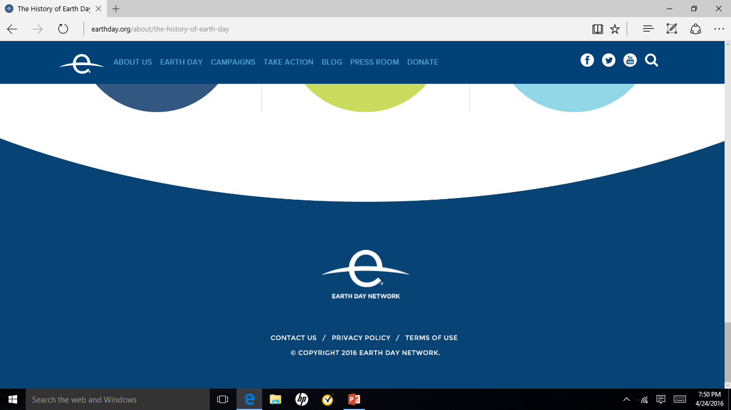

Slide 6
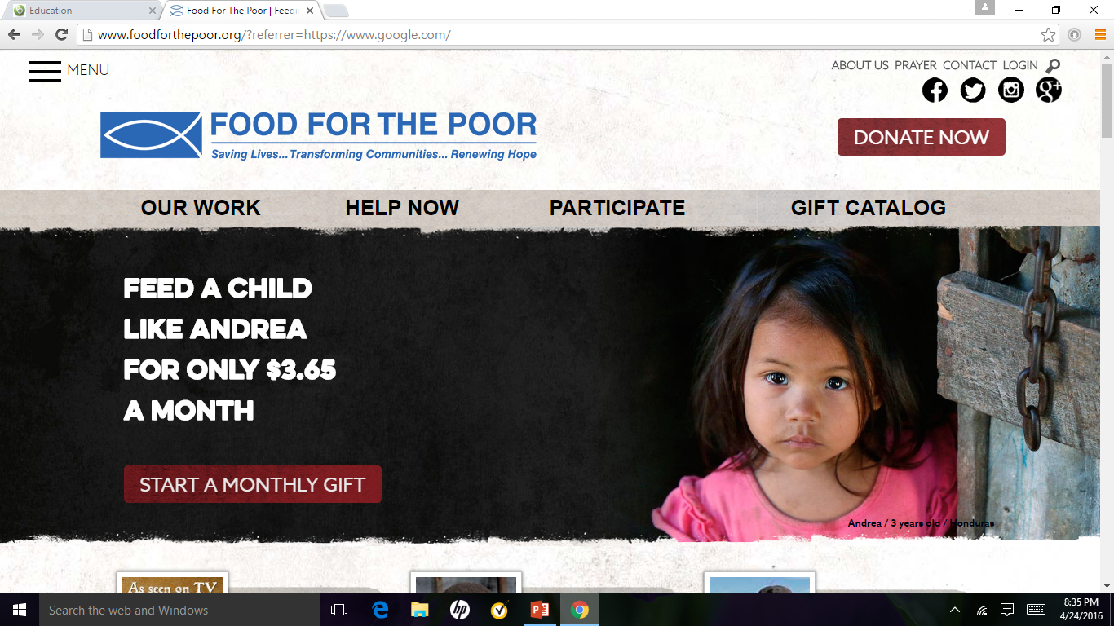
Sample web site

Slide 7
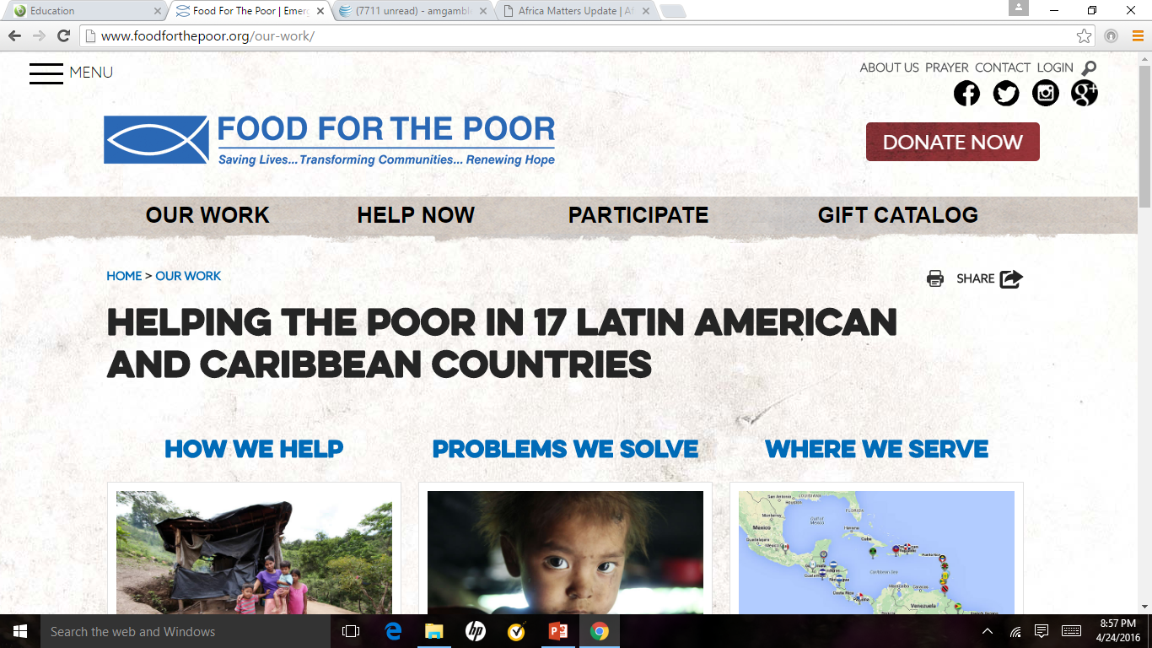

Slide 8
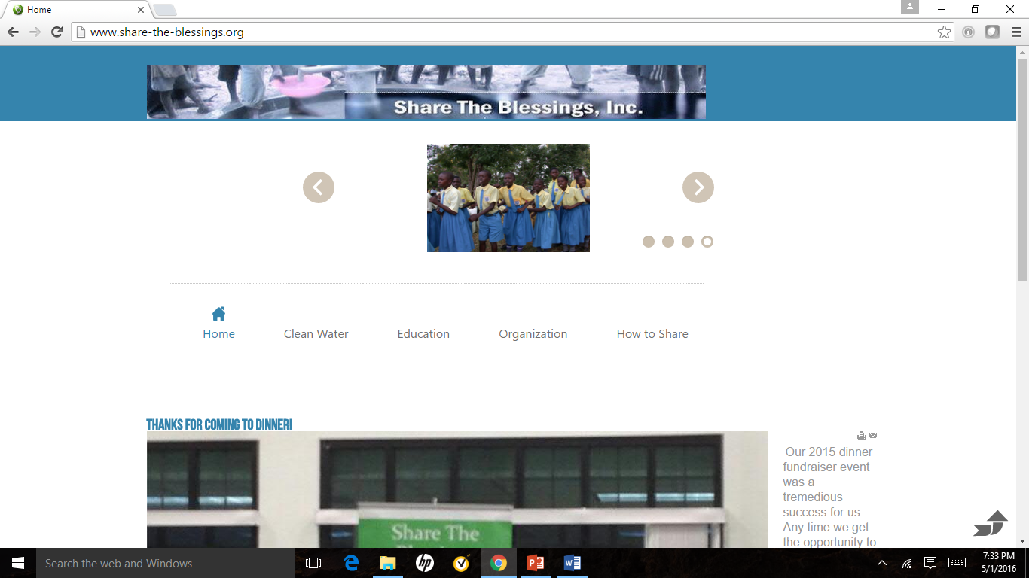
This is the current STB web site

Slide 9
STB web site home page
Create a home or landing page that includes links to the main focus areas of the organization in this order ➔ Organization; Clean Water; Education; Sponsorship; Volunteers.
The active links would be included in a banner beneath the header of the page. This would allow a visit to navigate anywhere within the web site; see “Food for the Poor” website as an example
The home page should include a graphic and/or animation that provides intuitive information about the purpose of Share the Blessings
When you hover over an object on the page that is an active link there should be a visible color change to indicate that the link is active

Slide 10
Clean Water web page
This page should include a graphic or animation that includes the wells that were successfully built.
There should be breadcrumbs on the page that would help the visitor navigate back to the home page
The active links would be included in a banner beneath the header of the page. This would allow a visitor to navigate anywhere within the web site; see “Food for the Poor” web site as an example.

Slide 11
Objects that are common to all pages on the site
The following objects should be common to all web pages within the site:
  A menu – to allow easy navigation
  A banner that contains links to all sections of the web site – all links change color when the mouse pointer hovers over it to indicate the user’s intended action.
  Bread crumbs that contains the path to the current location on the web site
  Links on the site to the specific article
  A print button – to allow printing
  A search mechanism
  A footer for the web pages – that would allow the visit to access additional information about Share the Blessings
  FAQ page
  A graphic or animation that illustrates the purpose of the information being provided.

Slide 12
Formatting common to all STB web pages
The text should share a common font type and size
  Banners
  Navigation links
  Article links
  Help links
The links should share a common color scheme format. If the link sits on top of a background the color should be the same for all links within the parent area.

Slide 13
All pages
First Pass by June
Login form available
Improved Menu System (home changes to About Us, organization available after individual logs on to the website)
Consistent Logo
More Appealing text that is consistent throughout
Future
More slides about the organization. With music and video in boxes on page.
Volunteer sign on
Sponsor sign on with details about their students and future payments, current payment status etc.
Well crowd sourcing capability – login to se

Slide 14
Main page - Plan
First pass by June
Implement layout from pages 6 and 7 of this deck
use our logo and simple name – stb
Simple message of who we are what we do
Use animation system from sandbox, include
Dinner Information with Linkable content
Request contributing
  Time – volunteer
  Funds for education or clean water(links)
Fr Joe video from sandbox animation
? Experiential Trips
? Technology program
Articles in the body / rest of page
Education articles
Water article
Very visible Area on page for donations
Second Pass/ Ongoing
Better logo area

Slide 15

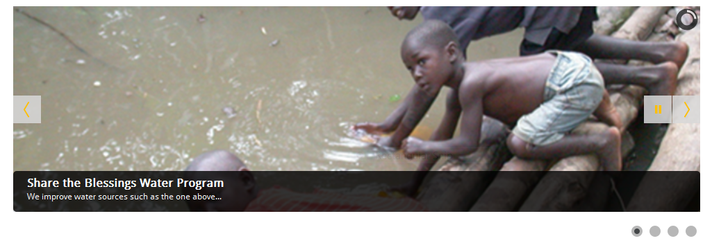
Main page – Layout part 1 of 3
Share the Blessings
Water and Education Programs for those in need!
Search
Slide with following elements
Water picture and link
Education picture and link
Dinner information and link
Fr Joe Video and link

Slide 16
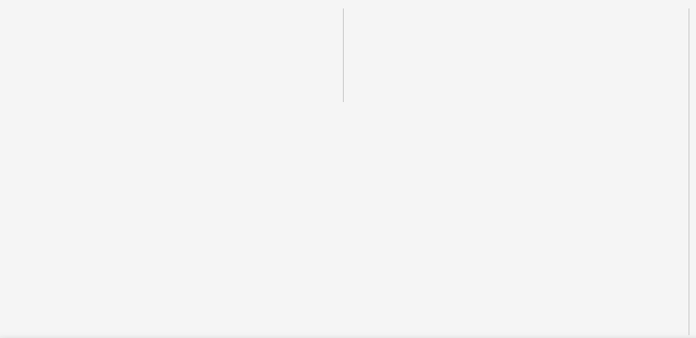
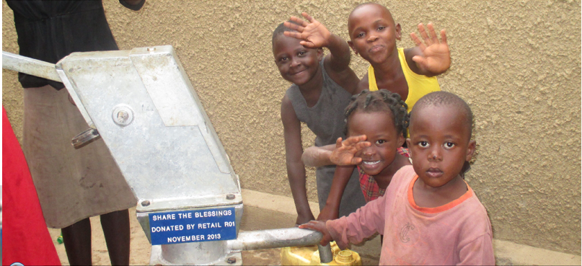

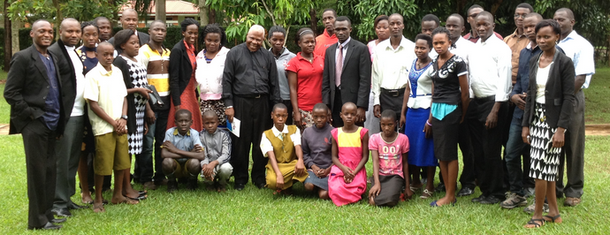
Main page – Layout part 2 of 3
Retail ROI 2016 grant to Share the
Blessings funds 2 wells for the year!
Retail ROI 2016 donation to Share the Blessings enables us to meet our annual goal of creating at least 2 clean water wells for the year. Thanks Retail Orphan Initiative!
Education Current
Alumni Students

Slide 17
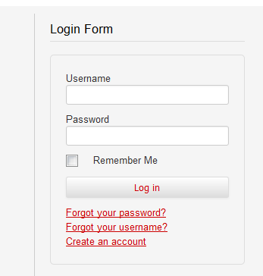

Main page – Layout part 3 of 3
SHARE THE BLESSINGS. Providing clean water. Educating students. Building hope.
Education: Hope for Tomorrow. Since 2002, Share the Blessings has provided tuition scholarships to primary, secondary, university and seminary students in Uganda. Our graduates have gone on to serve as teachers, engineers, shop owners, park rangers and Catholic priests. We currently sponsor 40 orphaned or at-risk students throughout Uganda and invite you to consider serving as an individual student sponsor.
"By wisdom a house is built, and by understanding it is established; and by knowledge
the rooms are filled with all precious and pleasant riches." Proverbs 24:3-4
Donate Now!
Volunteer
Provide your most precious gift your time! If you are able to share your time, please contact us and let us know how. Start by first registering and then complete our contact form letting us know how you would like to help.

Slide 18
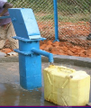
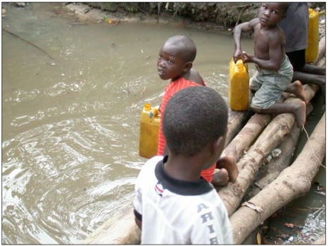
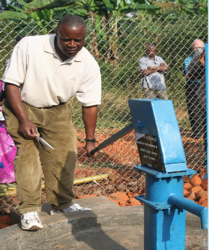
Water pages
First pass by June
Pages(sub menu items)
Description of the water program
  Annual goal
  Status for this year
  Retail ROI Article
Pictures showing the process
  Show plaque, tell can donate a well
Article on ways to fund a well
Second Pass
Table of wells and when constructed
What got us started with water
Well process

Slide 19
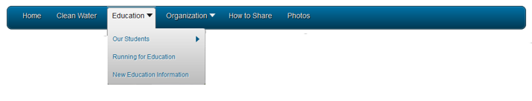
Education pages
First pass by June
Our students --- change to sponsor program
  Ability to email / contact Education chair
  Better description of sponsorship program with pictures
Education Goal Program has multiple facets
  Provide Education in Majority World – currently Uganda
    Support Child Education
    Support Religious Education
    Provide refurbished technology
  Provide Education for Minority
    Dinner
    School Visit
    Church Visit
    We visit groups of all sizes to provide awareness
Second Pass Ongoing
Explain school year
Explain how sponsorship works
Our Student Menu item
Animation with headshot of each student
Status of each student in the animation
Ability to sponsor a student from the site

Slide 20
Organization
First Pass
Improve our beginnings page
Information Menu item
  Better organization of page
  Add Telephone number
Keep General Contacts as is
Reformat Dinner Contact
  Format like General contact
  Majority World / Minority world definitions(don’t have to be published as long as menu get you off of page)
Second Pass Ongoing

Slide 21
How to show
First pass by June
Keep content
  Better format content
Second Pass Ongoing
List areas where need assistance

Slide 22
Updates from Organization
Use pages 15-17 that cover the main page as an example on including content for the Education, Water etc pages.

