Slide 1
Share the Blessings Web changes
2016 June Relaunch

Slide 2
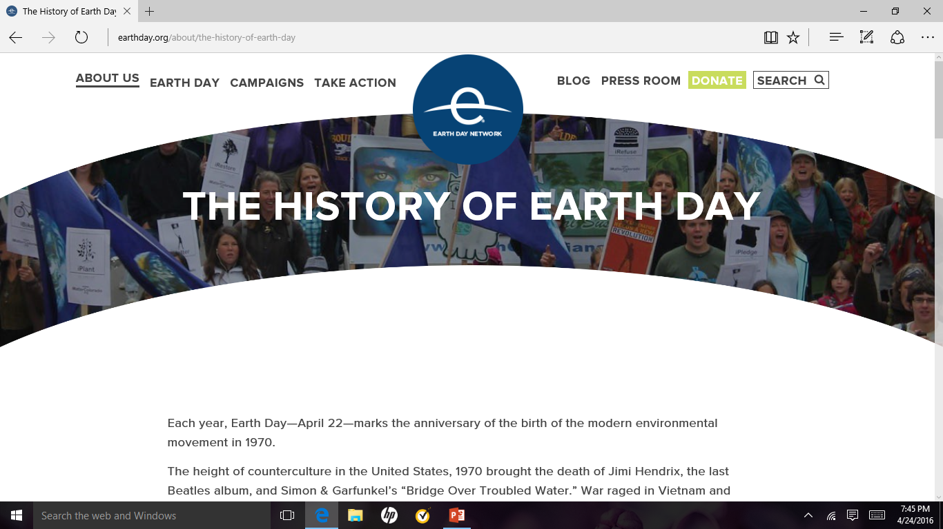
Sample web site www.earthday.org

Slide 3
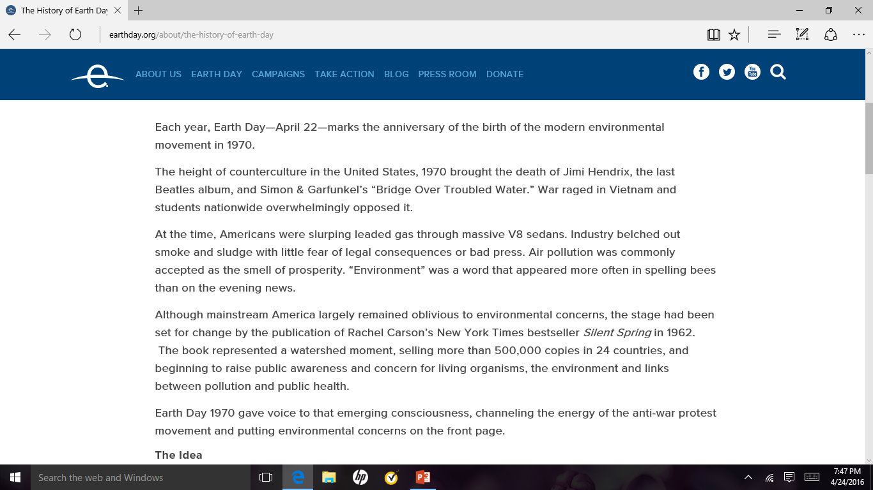

Slide 4
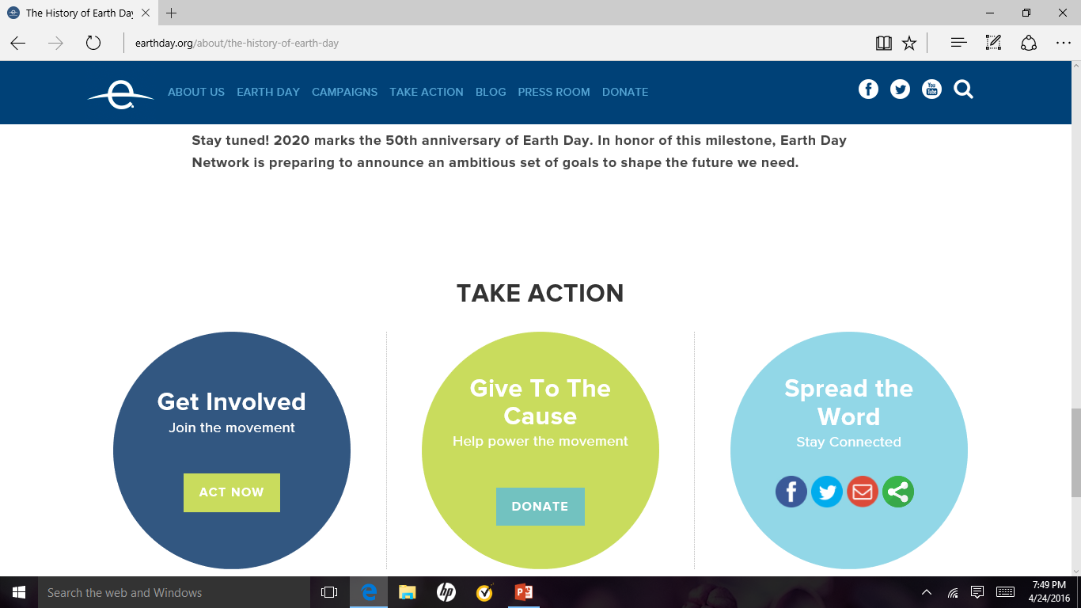
Here is the bottom of Earthday.org

Slide 5
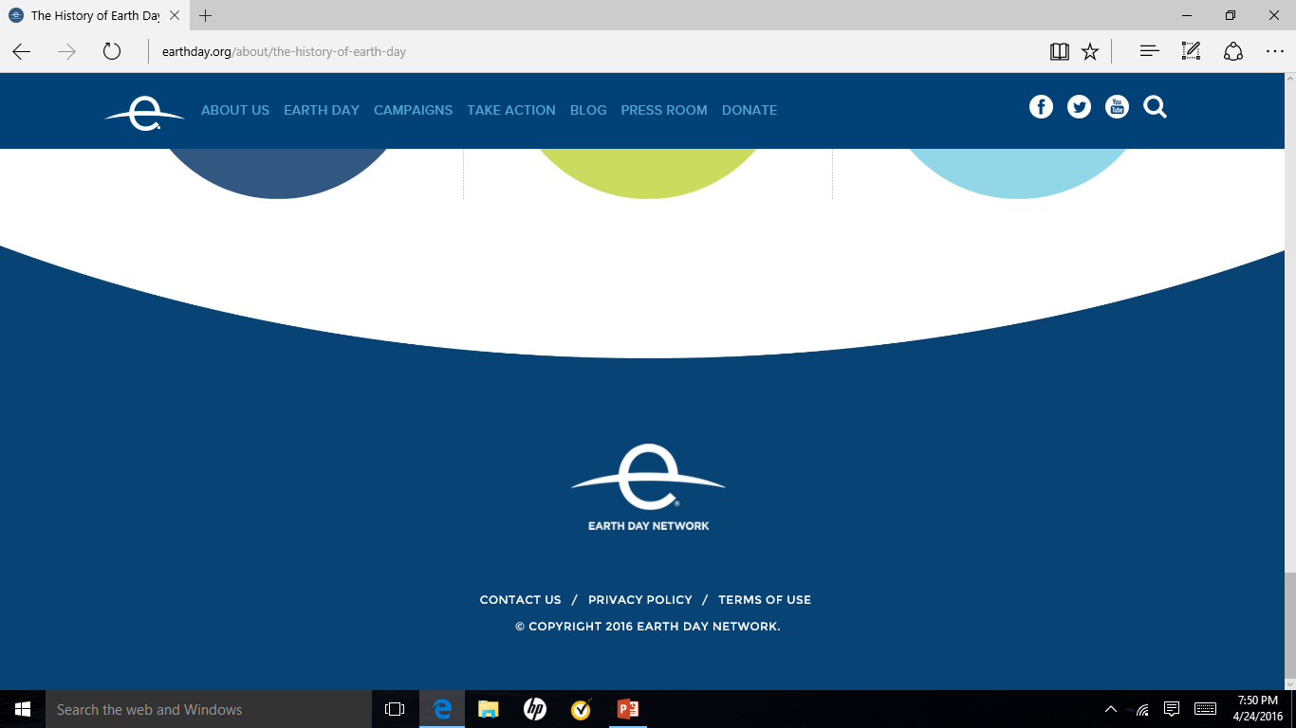

Slide 6
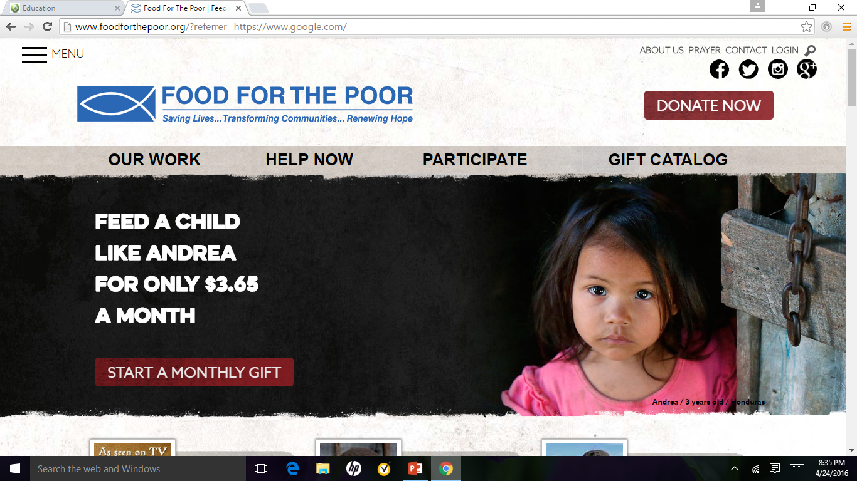
Sample web site

Slide 7
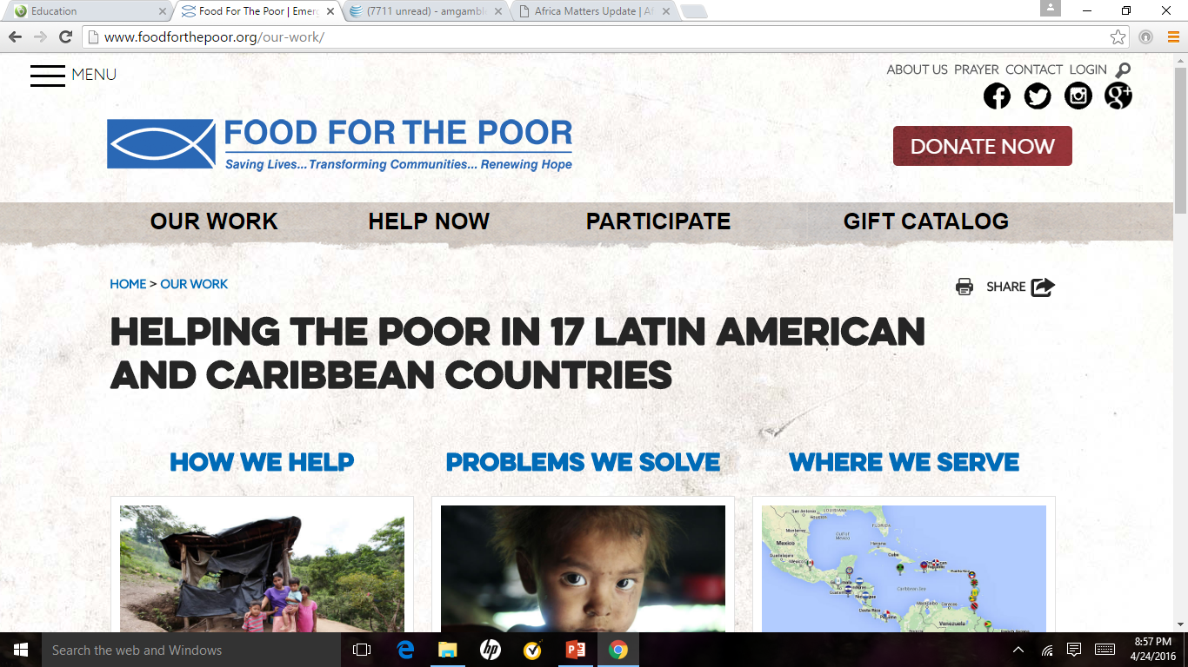

Slide 8
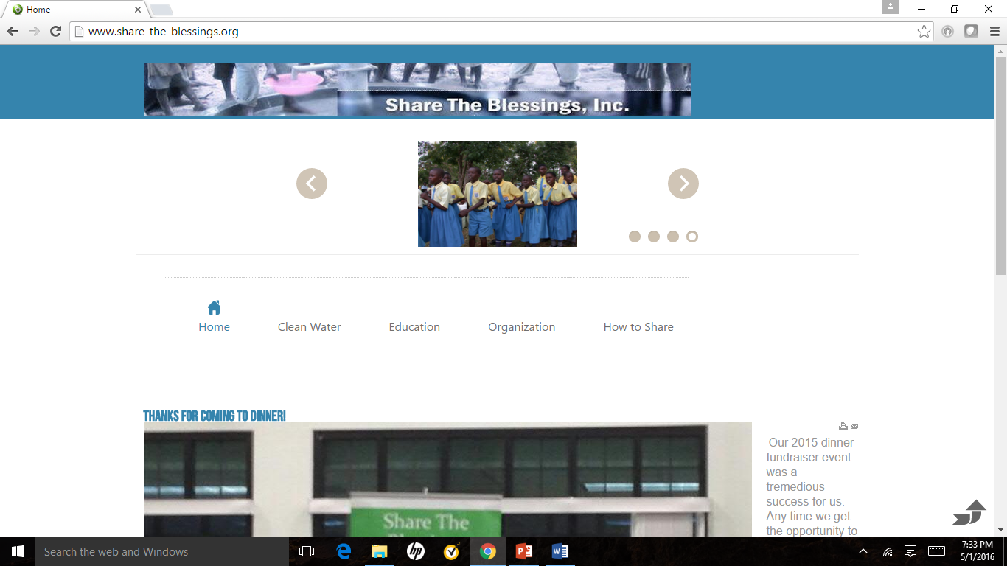
This is the current STB web site

Slide 9
STB web site home page
Create a home or landing page that includes links to the main focus areas of the organization in this order ➔ Organization; Clean Water; Education; Sponsorship; Volunteers.
The active links would be included in a banner beneath the header of the page. This would allow a visit to navigate anywhere within the web site; see “Food for the Poor” website as an example
The home page should include a graphic and/or animation that provides intuitive information about the purpose of Share the Blessings
When you hover over an object on the page that is an active link there should be a visible color change to indicate that the link is active

Slide 10
Clean Water web page
This page should include a graphic or animation that includes the wells that were successfully built.
There should be breadcrumbs on the page that would help the visitor navigate back to the home page
The active links would be included in a banner beneath the header of the page. This would allow a visitor to navigate anywhere within the web site; see “Food for the Poor” web site as an example.

Slide 11
Objects that are common to all pages on the site
The following objects should be common to all web pages within the site:
A menu – to allow easy navigation
A banner that contains links to all sections of the web site – all links change color when the mouse pointer hovers over it to indicate the user’s intended action.
Bread crumbs that contains the path to the current location on the web site
Links on the site to the specific article
A print button – to allow printing
A search mechanism
A footer for the web pages – that would allow the visit to access additional information about Share the Blessings
FAQ page
A graphic or animation that illustrates the purpose of the information being provided.

Slide 12
Formatting common to all STB web pages
The text should share a common font type and size
Banners
Navigation links
Article links
Help links
The links should share a common color scheme format. If the link sits on top of a background the color should be the same for all links within the parent area.

Slide 13
All pages
First Pass by June
Login form available
Improved Menu System (home changes to About Us, organization available after individual logs on to the website)
Consistent Logo
More Appealing text that is consistent throughout
Future
More slides about the organization. With music and video in boxes on page.
Volunteer sign on
Sponsor sign on with details about their students and future payments, current payment status etc.
Well crowd sourcing capability – login to se

Slide 14
Main page - Plan
First pass by June
Implement layout from pages 6 and 7 of this deck
use our logo and simple name – stb
Simple message of who we are what we do
Use animation system from sandbox, include
Dinner Information with Linkable content
Request contributing
Time – volunteer
Funds for education or clean water(links)
Fr Joe video from sandbox animation
? Experiential Trips
? Technology program
Articles in the body / rest of page
Education articles
Water article
Very visible Area on page for donations
Second Pass/ Ongoing
Better logo area

Slide 15

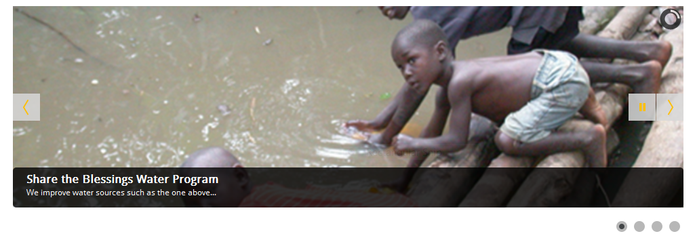
Main page – Layout part 1 of 3
Share the Blessings
Water and Education Programs for those in need!
Search
Slide with following elements
Water picture and link
Education picture and link
Dinner information and link
Fr Joe Video and link

Slide 16
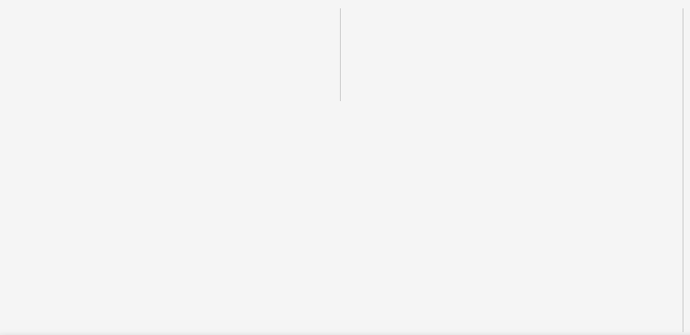
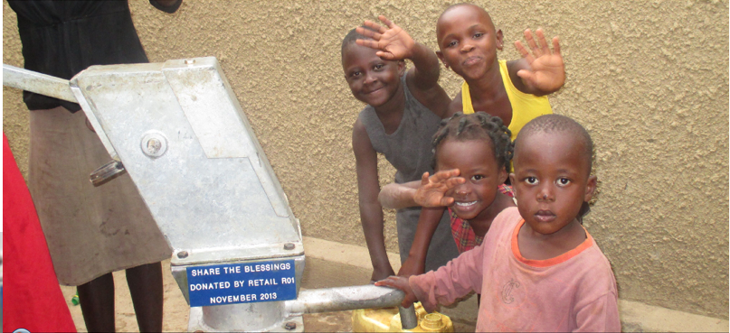

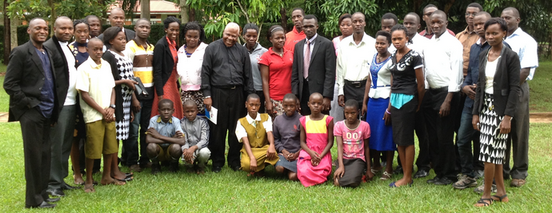
Main page – Layout part 2 of 3
Retail ROI 2016 grant to Share the
Blessings funds 2 wells for the year!
Retail ROI 2016 donation to Share the Blessings enables us to meet our annual goal of creating at least 2 clean water wells for the year. Thanks Retail Orphan Initiative!
Education Current
Alumni Students

Slide 17
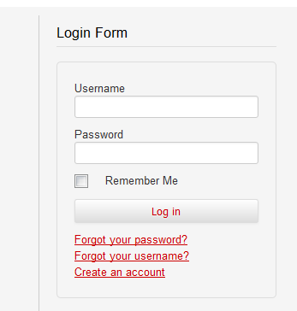

Main page – Layout part 3 of 3
SHARE THE BLESSINGS. Providing clean water. Educating students. Building hope.
Education: Hope for Tomorrow. Since 2002, Share the Blessings has provided tuition scholarships to primary, secondary, university and seminary students in Uganda. Our graduates have gone on to serve as teachers, engineers, shop owners, park rangers and Catholic priests. We currently sponsor 40 orphaned or at-risk students throughout Uganda and invite you to consider serving as an individual student sponsor.
"By wisdom a house is built, and by understanding it is established; and by knowledge the rooms are filled with all precious and pleasant riches." Proverbs 24:3-4
Donate Now!
Volunteer
Provide your most precious gift your time! If you are able to share your time, please contact us and let us know how. Start by first registering and then complete our contact form letting us know how you would like to help.

Slide 18
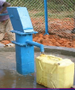
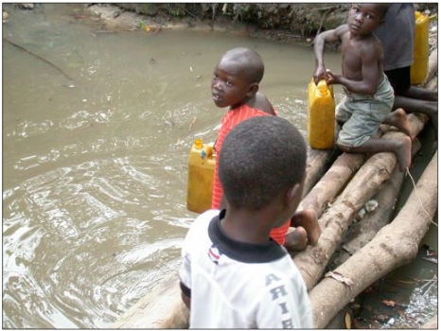
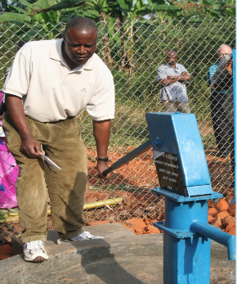
Water pages
First pass by June
Pages(sub menu items)
Description of the water program
Annual goal
Status for this year
Retail ROI Article
Pictures showing the process
Show plaque, tell can donate a well
Article on ways to fund a well
Second Pass
Table of wells and when constructed
What got us started with water
Well process

Slide 19
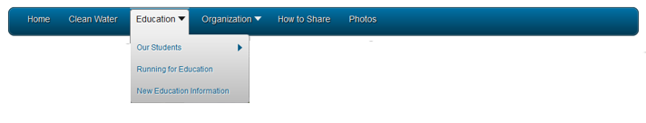
Education pages
First pass by June
Our students --- change to sponsor program
Ability to email / contact Education chair
Better description of sponsorship program with pictures
Education Goal Program has multiple facets
Provide Education in Majority World – currently Uganda
Support Child Education
Support Religious Education
Provide refurbished technology
Provide Education for Minority
Dinner
School Visit
Church Visit
We visit groups of all sizes to provide awareness
Second Pass Ongoing
Explain school year
Explain how sponsorship works
Our Student Menu item
Animation with headshot of each student
Status of each student in the animation
Ability to sponsor a student from the site

Slide 20
Organization
First Pass
Improve our beginnings page
Information Menu item
Better organization of page
Add Telephone number
Keep General Contacts as is
Reformat Dinner Contact
Format like General contact
Majority World / Minority world definitions(don’t have to be published as long as menu get you off of page)
Second Pass Ongoing

Slide 21
How to show
First pass by June
Keep content
Better format content
Second Pass Ongoing
List areas where need assistance

Slide 22
Future Considerations

Slide 23
Different access for User types
General / Public Users
Informational site – Key message / content that needs to be communicated.
Sponsors
Donors
Internal Organization
Operational Site

Slide 24
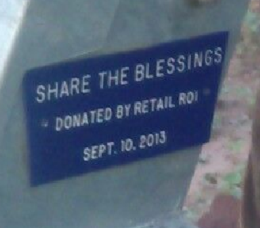
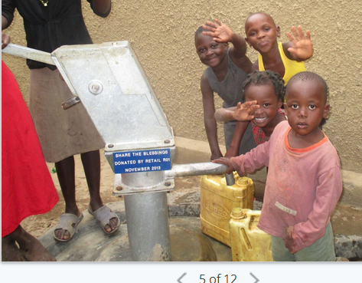
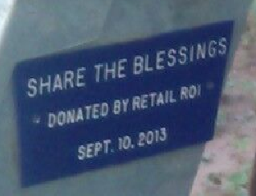


Slide 25
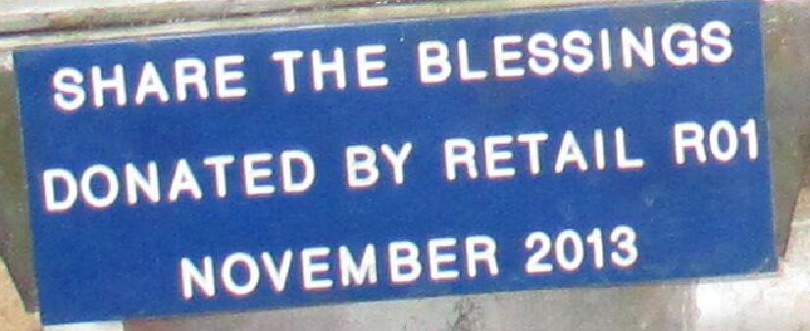

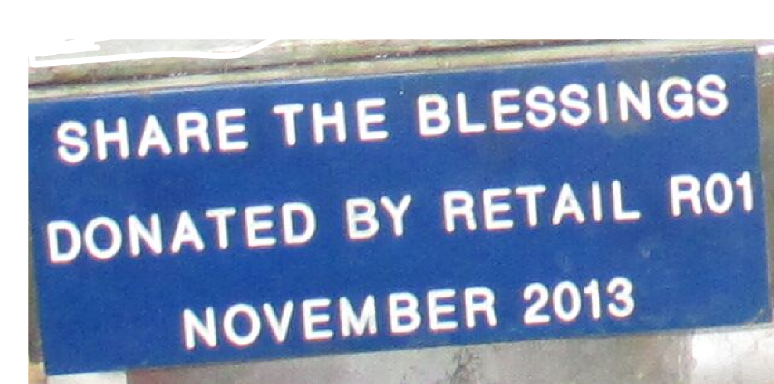

Slide 26
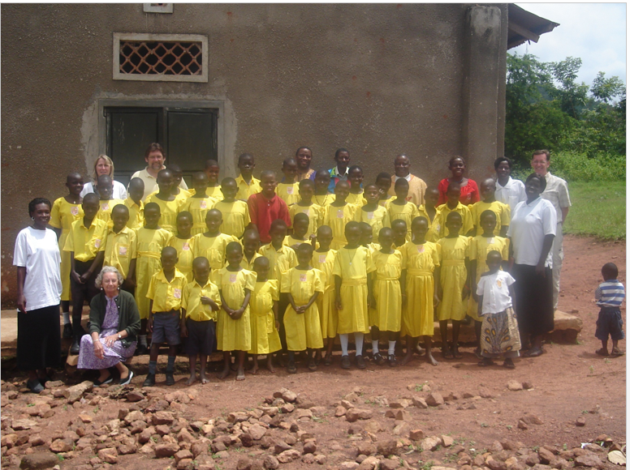
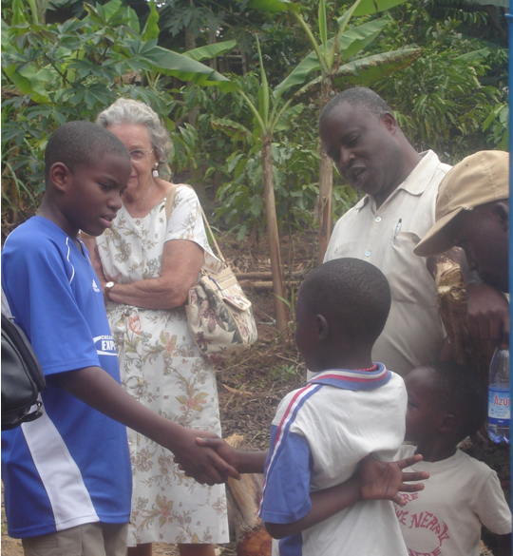
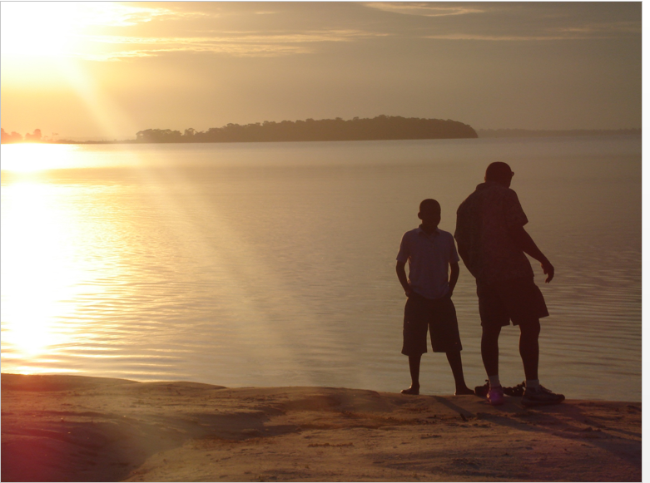

Slide 27
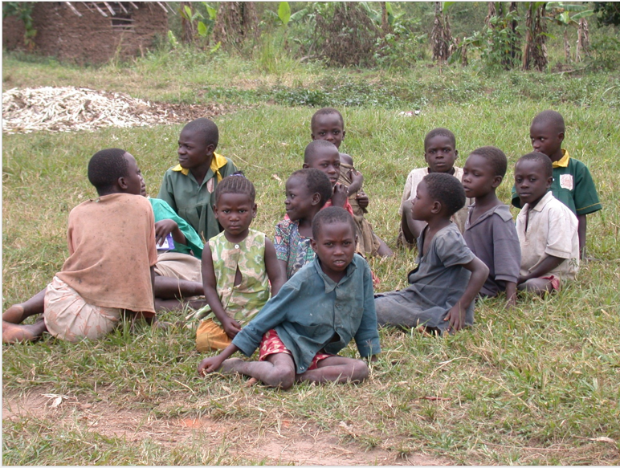

Slide 28
Main page – Layout part 1 of
Search
Share the Blessings
Clean Water and Education Programs for the Majority World
Slide with following elements
Water picture and link
Education picture and link
Dinner information and link
Fr Joe Video and link
Sharing our blessings via Clean Water and Education Programs!

Slide 29
Share the Blessings Web changes
Technical Details

Slide 30
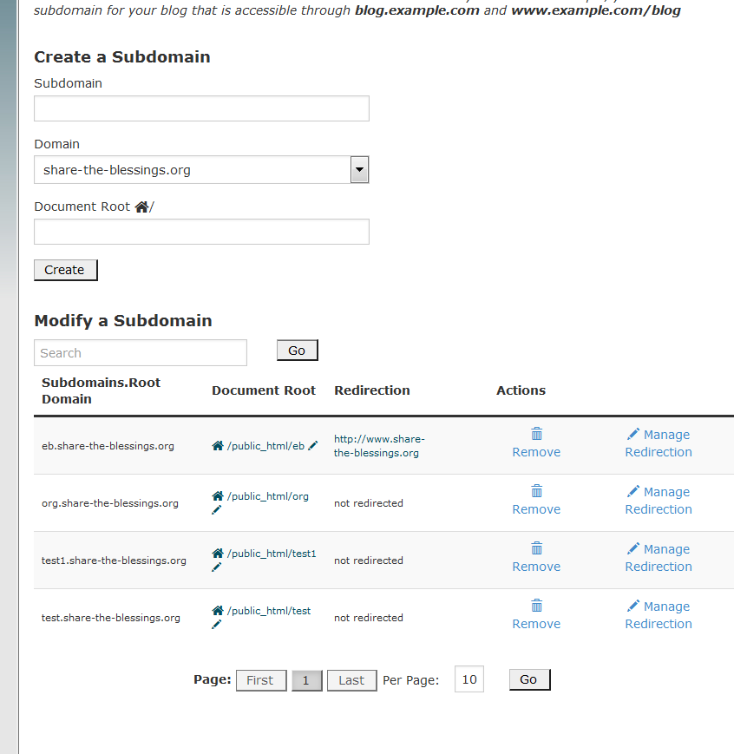
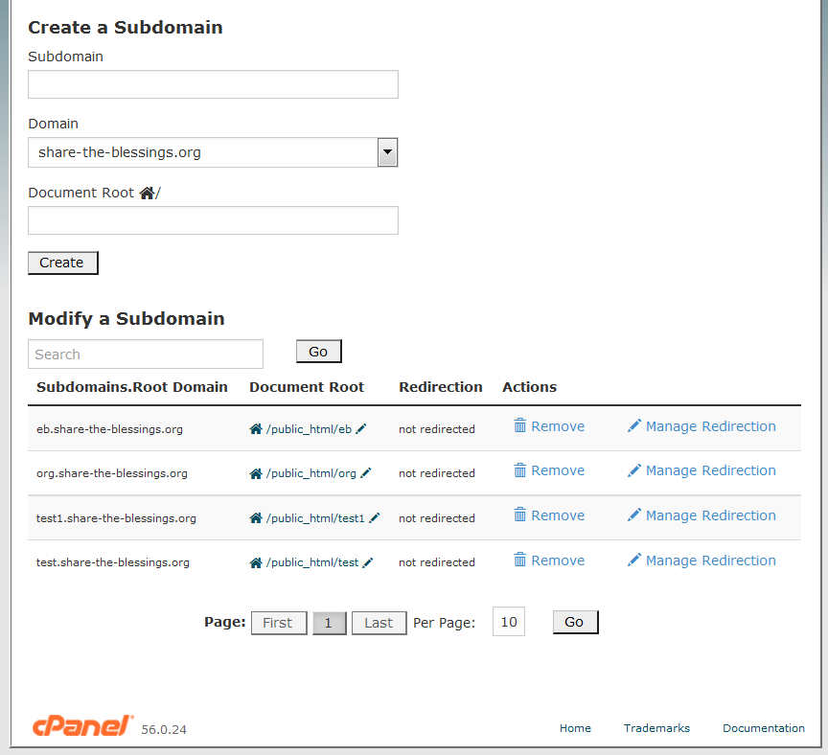
Plans
Copy content from main site to a subdirection – prod1
Setup a pointer to replace index.html that points to prod1
Load
https://www.ostraining.com/support-forum/joomla-support/joomla-website-in-a-subdirectory-htaccesstxt-file/
Re-directed eb back to www.share-the-blessings.org
Thinking to redirect www.share-the-blessings.org to
Help.share-the-blessings.org

Slide 31
Initial thoughts for moving prod into live site
Can see how it works to move current sandbox to / . Other steps
Copy content
Setup directories
Get users to setup again
Still got to get color schema to match what have in this powerpoint
Saved steps
Don’t have to find an reinstall plugins etc
Don’t have to worry about the ability to login and create articles hopefully
Don’t have to get Rock to sign in again

Slide 32
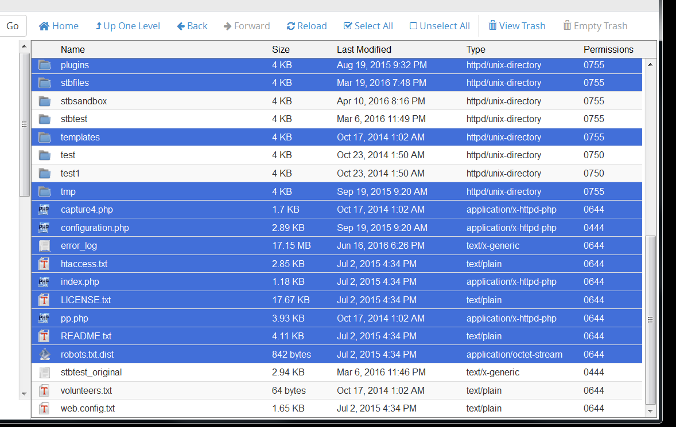
Files copied to stbprd7 or moved to backup?

Slide 33
Steps as of 6/27 updated 6/28 add 3.x
Found that I have from going to administrator system information -
Joomla! 3.4.3 Stable [ Ember ] 2-July-2015 16:00 GMT
See from notes that need to backup the database – stbprd5 both copied to stbprd6 and exported to laptop
Congratulations, the software was installed successfully
Joomla has been successfully installed at : http://share-the-blessings.org/stbprd6 Administrative URL : http://share-the-blessings.org/stbprd6/administrator We hope the installation process was easy. NOTE: Softaculous is just an automatic software installer and does not provide any support for the individual software packages. Please visit the software vendor's web site for support! Regards, Softaculous Auto Installer
Database –from config in stbprd6 blessing_joom727
public $user = 'blessing_stbprd5';
public $password = '6!@PvS7P6t';
public $db = 'blessing_stbprd5';
public $dbprefix = 'stb_';
public $live_site = '';
public $secret = '50cm8k3yn7e1b9eu';
Drop 68 but imported 86 tables… other components
Current plan
Backup current db
Follow up backup restore from notes
Install new into subdirectory
Restore db
Install key components
Ari – no it was CK
Pull main page articles from sandbox
Customize
Prep for outage???
Backup entire /public_html minus the other websites ie /stbtest and stbprd7 and org
Redirect to subdirectory
Copy subdirectory to main
Verify operational
Include create articles

Slide 34
Deleted the install from yesterday for stbprd6 as didn’t make it ssl. When tried to log in said it didn’t support ssl and wanted me to sign etc. Also deleted database from that install as well as stbprd6 which was a copy of stbprd5.
Joomla has been successfully installed at : https://www.share-the-blessings.org/stbprd7 Administrative URL : https://www.share-the-blessings.org/stbprd7/administrator We hope the installation process was easy. NOTE: Softaculous is just an automatic software installer and does not provide any support for the individual software packages. Please visit the software vendor's web site for support! Regards, Softaculous Auto Installer
Dropped tables and then imported
Import has been successfully finished, 216 queries executed. (blessing_stbprd5(1).sql)

Slide 35
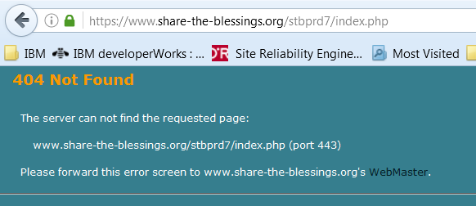
Login form encypt issue1 – not resolved!
6/28
Changed the login form to be on beez and logged on as kevin and got this error. Think it is a template issue.
Ok noticed that couldn’t find any solutions to this one on the web in my brief searches. But also noticed that under admin/extentions/module mgr/login that is not encrypted on stbtest but is encrypted on stbprd7. But when unencrypting on stbprd7 I don’t get this message!!! This is a problem that needs to be solved later. Further on the production site login IS encrypted!!! So logins aren’t secure on stbtest or stbprd7 but are on prod. This might be an htaccess and subdirectory. Discuss with Ken and maybe get Rock to run it down.

Slide 36
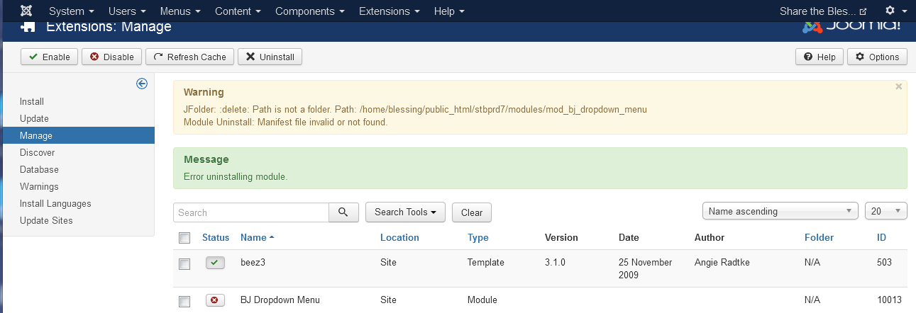
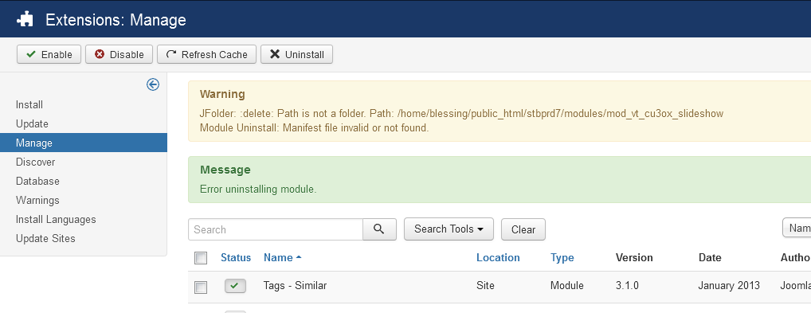
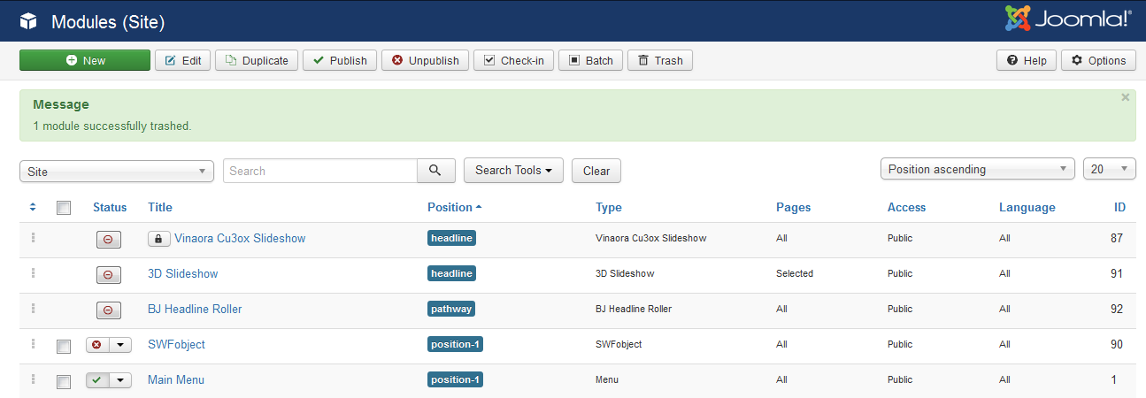
Launch progress another source for checking out – https://www.youtube.com/watch?v=B-7jsURjLiU
6/28 Was successful in logging in and creating an article in stbprd7. Continuing with slide 33 steps. Despite desire to fix the look and feel to improve via a new template, that will come later. Want working menus and updating to take precedence over trying to perfection – MVP!
Also have an issue in that Lauren updated the education article for pilgrims 2016! Need to capture that in the backup.
Currently at 2.2
Need to clean up the rest of stbprd7 ie remove other components no longer using
Vinaora Cu3ox Slideshow
WWM Banner Slideshow
3D slideshow
BJ Headline roller
SWFObject
Phoca Gallery Slideshow bxSlider
swMenuFree
Smagrid jquery multigallery
Need to go to stbtest site to see what I have there.
ari
Need video in right location
Need pictures in right place from home page

Slide 37
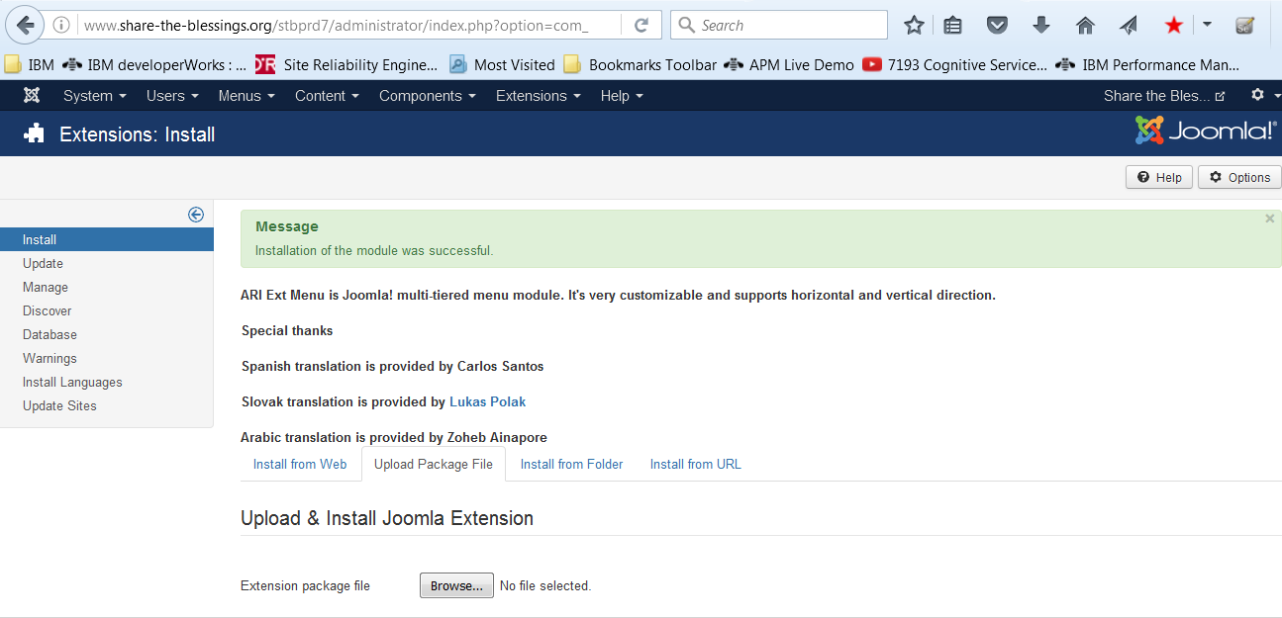
Which tools did we settle on for Stbtest
Mistake with ari should not have installed went back and found on stbtest that it was maxmenu ck
Need to fix this by removing Ari

Slide 38
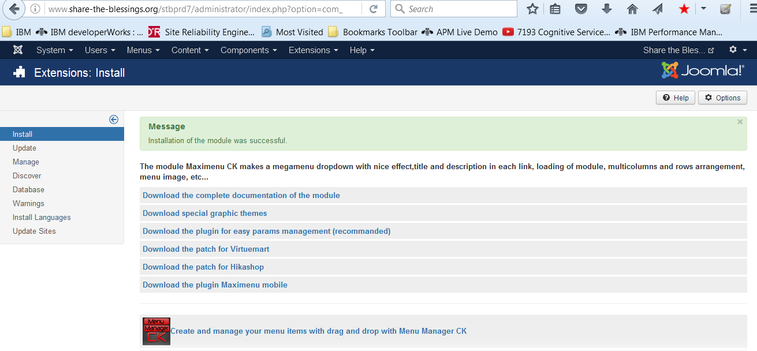
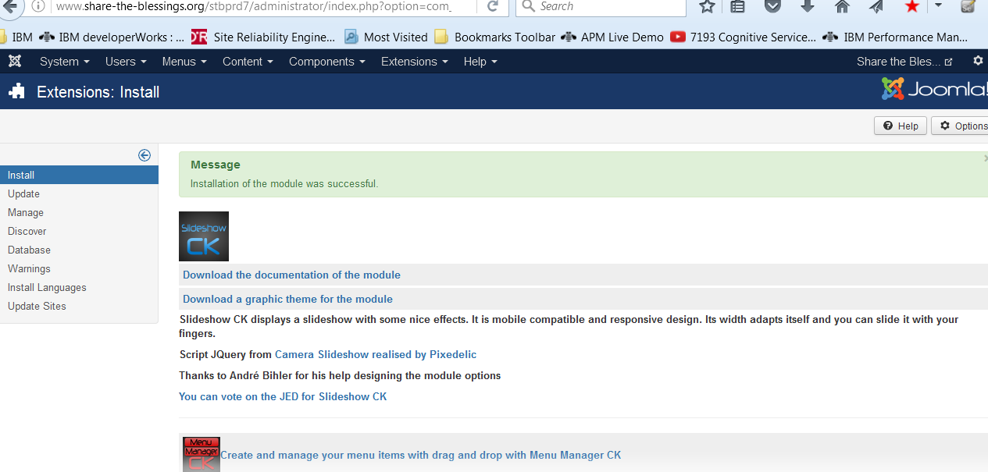
CK Software
Got email off to Martina to leave 75 in the account to purchase software. Need to review for manuals or what we should purchase first.
Found maximenu ck online
Hardest time getting the menu to show in breeze followed the stbtest example. Key was having it in position -2. But think that was an issue with menu hiding behind the gratphic at the top but that is unproven.
Going after ck slidershow now
Found slideshow ck on hard drive
Which location is video used from? – done utube
Are pictures sized ok and available - no
Need to get Logo to website - outstanding
Need to build home page top banner –
Need to setup sub pages - na
Future our story with slides / soundtrack from Emmanuel leaving

Slide 39
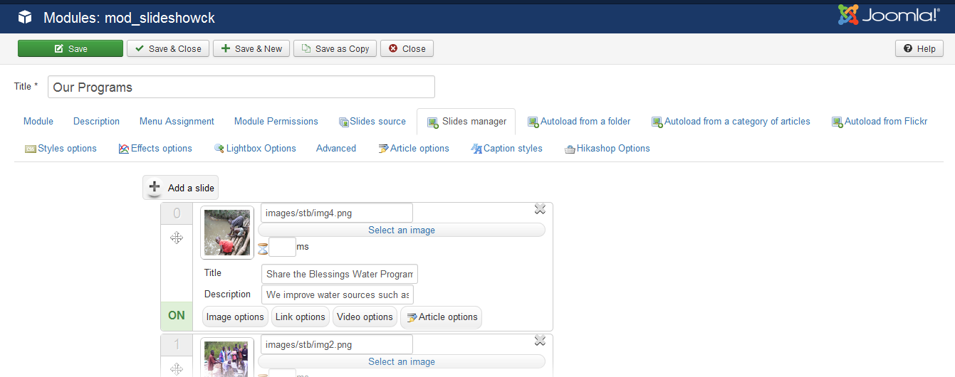
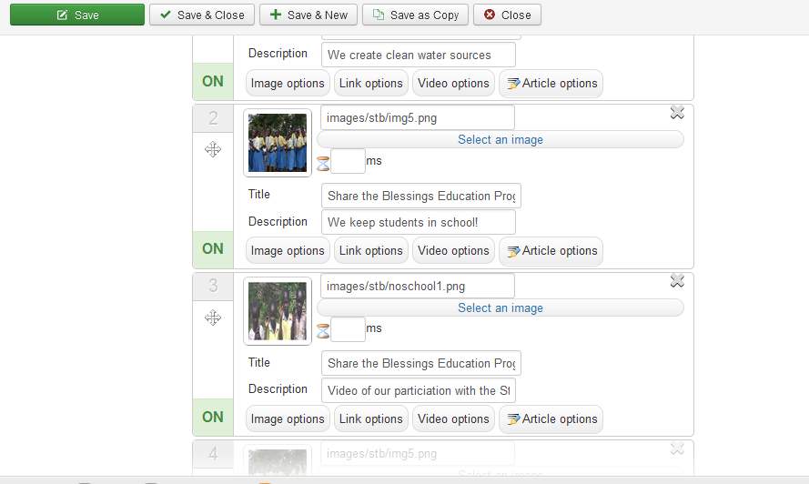
Using Slideshow CK
Source for the video
https://www.youtube.com/embed/hZvn-8nRl5Q?rel=0&autoplay=0
Need to get images from current directory. Easiest way is to just copy them to under stbprd7 and when move it to / then the images will be there and can just delete the current site location...(after a backup)
Copied media, images and stbfiles from / to /stbprd7 that worked

Slide 40

Original plans for header
Share the Blessings
Water and Education Programs for those in need!

Slide 41
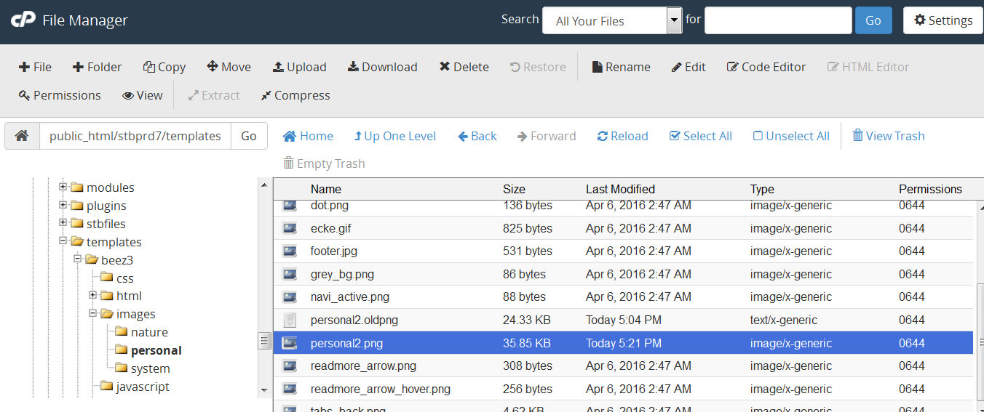
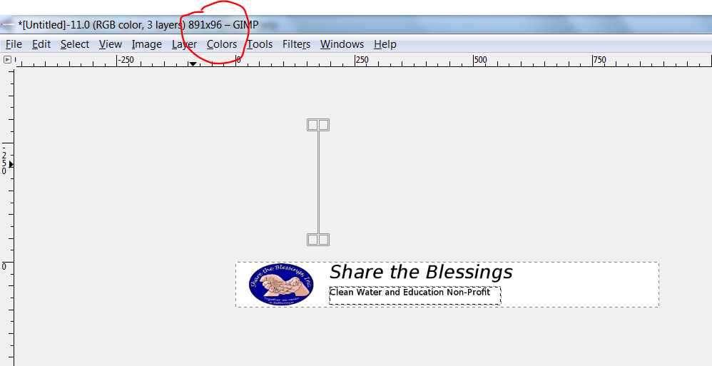
Switch template from beez to protostar
Struggled tremendously with getting the beez logo area to look as I wanted it to. Couldn’t get beyond extra blue area above the personal2.png that I saved in 2016 directory. Wound up going to template/images/personal subdirectory and replacing that file. As couldn’t get it to work otherwise.
Used this same logo for protostar and it looks good enough. And didn’t have to mess with template directory!
Now need to get other pictures looking a little better in the slideshow. Sent email to slideshow cK about the 183 days. Per this snip pictures for slideshow should be about 250 height and maybe 1000 width.

Slide 42
We convert villages primary source of water from mud holes to clean water wells
One of our primary Education Program objectives is Child Educaiton – keeping Children in school
Education also involves educating us here in the Minority world – Experiential trips, Dinners and Event attendance Presentations
public_html/stbprd7/images/images/phocagallery/education
This slideshow uses a JQuery script adapted from <a href="http://www.pixedelic.com/plugins/camera/">Pixedelic</a>

Slide 43
Working tables on main page to span full width
<td style="width: 186.05px;"> </td>
<td style="width: 31.95px;">
Also did table span 100% to get across the entire page
<table style="width:100%"><table style="width:100%"><table style="width:100%">
Found that note only is there a global configuration and a space to reach configuration for number of lead articles in the article section but there is also one controlled by the menus. Also there is a place to control the order of articles there as well.

Slide 44
Footer plans given on area at footer
Thinking about the footer – thought is to place the login in article within a table. Two other cells of the table in that article have the donate capability and request to share themselves as seen in this document. Then that article is placed in the footer.
To accomplish both of the following are required. Test on STBtest first
https://docs.joomla.org/How_do_you_put_a_module_inside_an_article%3F
http://extensions.joomla.org/extension/article-placed-anywhere

Slide 45
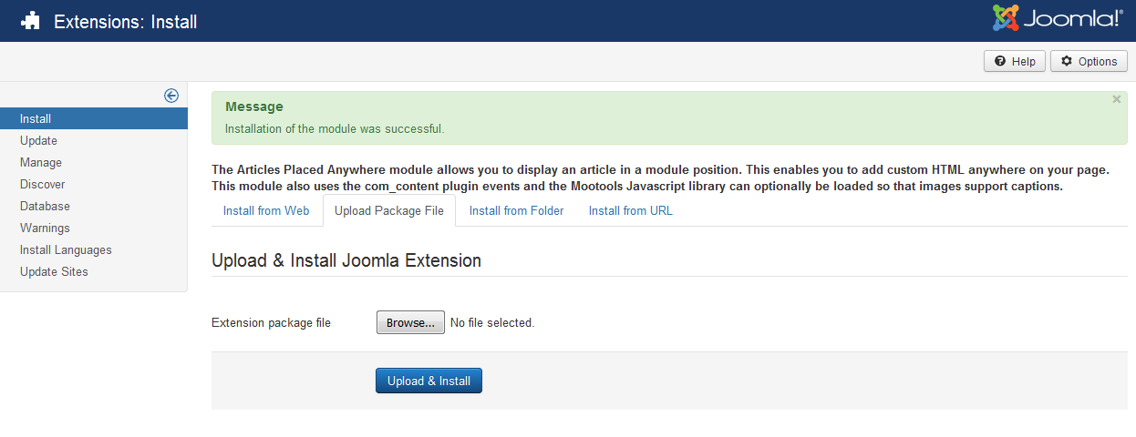
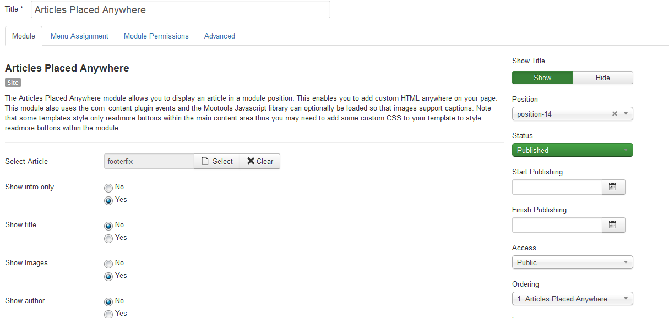
Working on footer – placing article in footer section

Slide 46
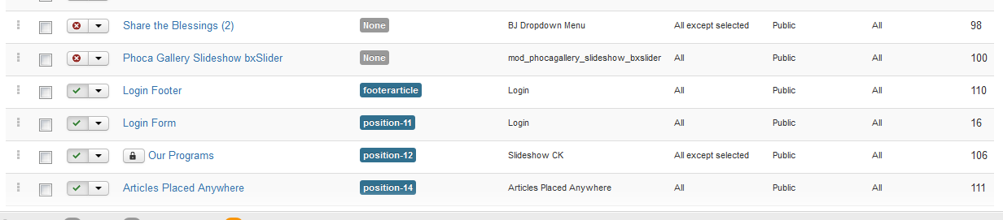
Working on the footer for protostar

Slide 47
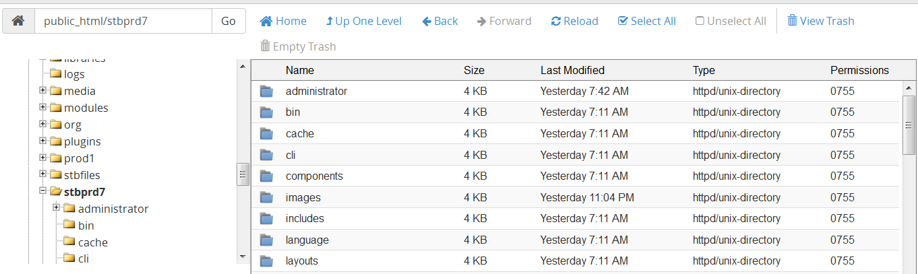
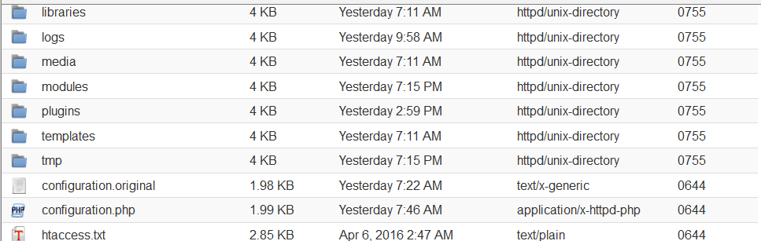
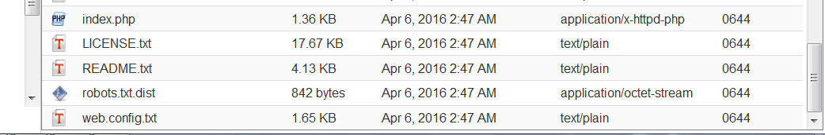
Early thoughts on big move to new web site

Slide 48
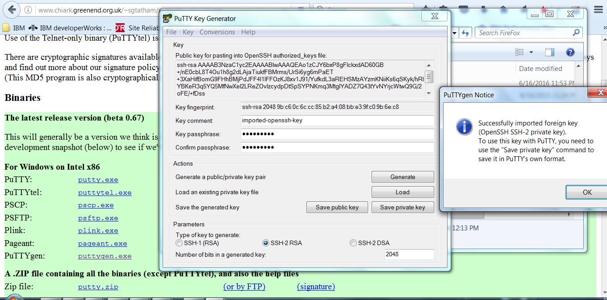
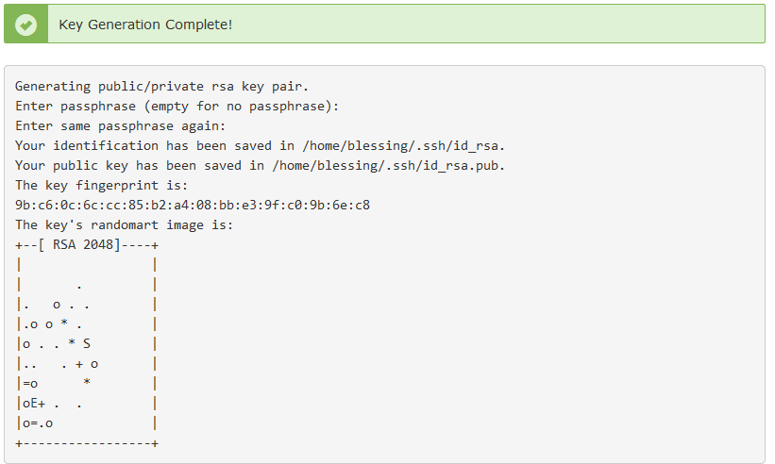
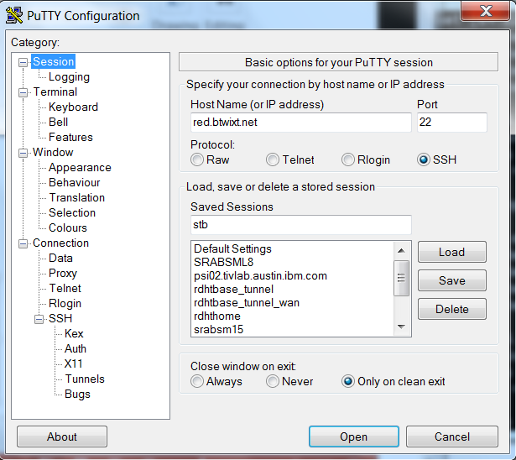
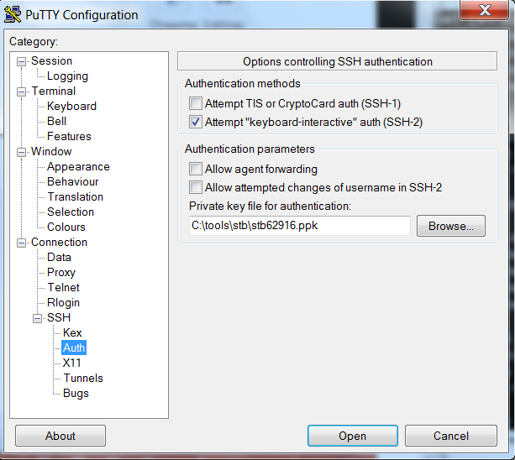
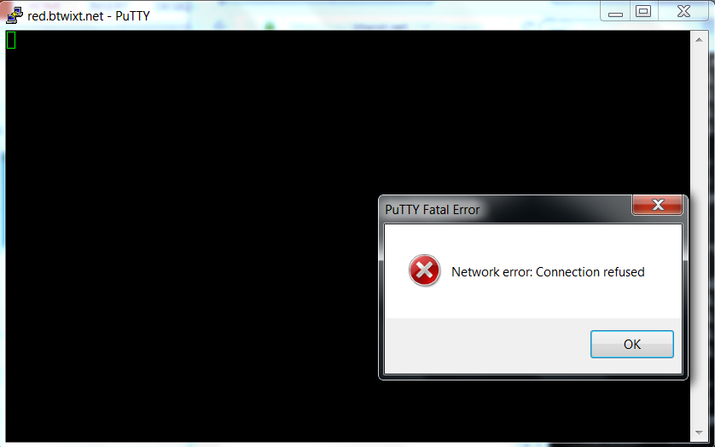
Pursuit of Tools to get copy of files to move
What makes up joomla that needs to be moved simple look at stbprd7
red.btwixt.net
https://devops.profitbricks.com/tutorials/use-ssh-keys-with-putty-on-windows/
Believe btwixt doesn’t allow even though they have the ssh key generation on the page.

Slide 49


/ site files
File manager
Move folders
Admin
Bin
Cache
Cgi-bin
Cli
Components
Images
Includes
Language
Layouts
Lbraries
Logs
Media
Modules
Plugins
Templates
Tmp
f
File manager
Move fiels
Configuration.php
Index.php
Licencense.txt
Readme.txt
Webconfig.txt
Prod1 / stbfiles /stbprd7

Slide 50
From prd7
File manager
Move folders
Admin
Bin
Cache
Cgi-bin
Cli
Components
Images
Includes
Language
Layouts
Lbraries
Logs
Media
Modules
Plugins
Templates
Tmp
File manager
Move fiels
Configuration.php
Index.php
Licencense.txt
Readme.txt
Webconfig.txt
robots
Prod1 / stbfiles /stbprd7

Slide 51

The big move worked without any other changes!!!
Did a little clean up got rid of stbfiles from stbprd7 and prod1 directories.
At some point can blow away retired
These are the files / directories moved to retired. The equivalent were copied from stbprd7 to /

Slide 52
Login form encypt issue1 – maybe resolved!
7/1
One of the test performed was to change the login module used with the footer article to be encrypted. Can’t discern that https is being used but the selection is clearly encrypted. Think the issue may have been the location ie / vs /stbprd7. But not sure. Should investigate and examine .htaccess.

Slide 53

Org site contacts vs main site.
Need to get contacts on new production site working. Appears somehow we are going to org
Meeting tool candidates
http://www.meeting2win.com/index.php?page=shop.product_details&flypage=flypage_meetings.tpl&product_id=68&category_id=16&option=com_virtuemart&Itemid=1

